Slide 1
BLOODHOUND ALUMINIUM DESERT WHEELS DESIGN & TECHNOLOGY CHALLENGE
Register now! (Deadline 22 February 2019)
Submit your project by 1 March 2019
Sponsored by

Slide 2
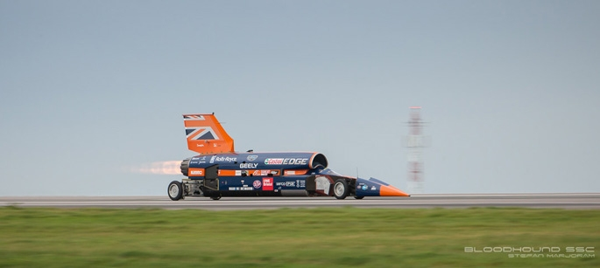
The BLOODHOUND PROJECT
Before we start, let’s watch a short video that introduces the BLOODHOUND Project:
https://www.youtube.com/watch?v=2lUGOC692fI

Slide 3
The BLOODHOUND PROJECT
What do you know about BLOODHOUND SSC?
1. How fast could it go?
6. What is the limiting factor of our speed? (What stops the Car going faster than 1,000 mph?)
2. What is it powered by?
5. Where are we going to test it?
4. What is it made of?
3. How does it slow down?

Slide 4
The BLOODHOUND PROJECT
What do you know about BLOODHOUND SSC?
1. How fast could it go?
1,000mph
6. What is the limiting factor of our speed? (What stops the Car going faster than 1,000mph?)
2. What is it powered by?
A jet engine from a Typhoon and a rocket from the space programme
The wheels could shatter and break if they spin faster than 170 times a second…
5. Where are we going to test it?
4. What is it made of?
3. How does it slow down?
Carbon fibre, aluminium, titanium, steel, kevlar…
Air brakes
Parachutes
Wheel disc brakes
Hakskeen Pan, a dry lake bed in South Africa

Slide 5
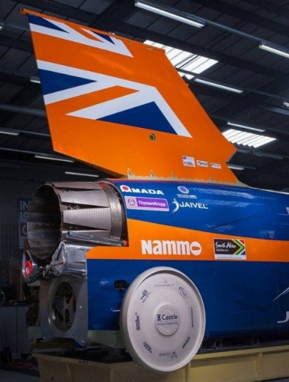
The Challenge
Design all-terrain aluminium wheels for the next World Land Speed Record car
BLOODHOUND SSC needs a long distance to speed up to 1,000mph and then slow down safely.
Hitting a stone could break a wheel, so we had to remove nearly 16,000 tonnes of stones by hand from our track in South Africa.
Can you help our engineers to design all-terrain wheels to cope with a rough track?

Slide 6
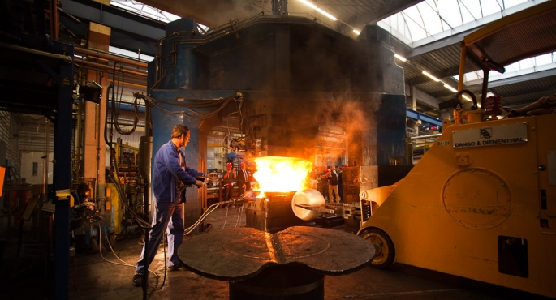
BLOODHOUND SSC’s wheels
Let’s watch a short video on how the fastest wheels in history were made from aluminium: https://www.youtube.com/watch?v=K_ImAm1WhcY

Slide 7
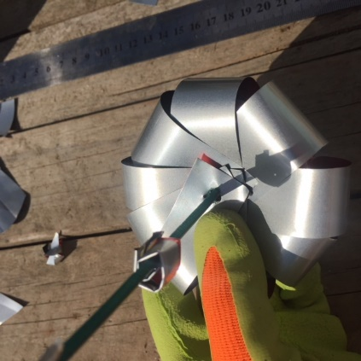
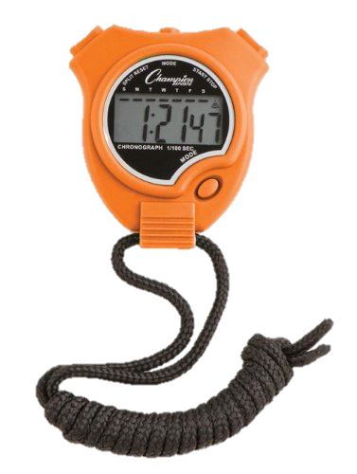
The Competition
1. Research Hakskeen Pan to make an authentic test track.
2. Design some wheels to test, made from aluminium cans.
3. Build a prototype BLOODHOUND car to test your wheels on.
4. Measure the speed the car goes on the track – how will you do this?
5. Keep testing and improving to make the fastest wheels possible, then share your discoveries in a poster and video diary.

Slide 8
How to win – and what you win!
Everyone in Years 3-6 can take part. Each school, club or group then chooses a team per year group (or one combined team) to enter the competition.
Send in each team’s poster & video diary (3 minutes max) to be assessed by the BLOODHOUND Team, who will judge teams on their problem-solving abilities and creativity.
Ten teams will be invited to see BLOODHOUND SSC, meet the Team and demonstrate their wheel design.
The winning team wins a Rocket Car workshop* for their school/club/group.
*Or other workshop – you choose!
Register now!
Download resources from our website: www.BLOODHOUNDSSC.com
Enter by 1 March 2019

